Slide 1


Team 22: Solar Home Lighting
Bi-Weekly Update 3 Jack Holdridge
Kyle Walcher
Matthew Greer
Adam Garcia
TA: Guanhua Tao
Sponsor: Won Jang
Notes:
Michelle

Slide 2
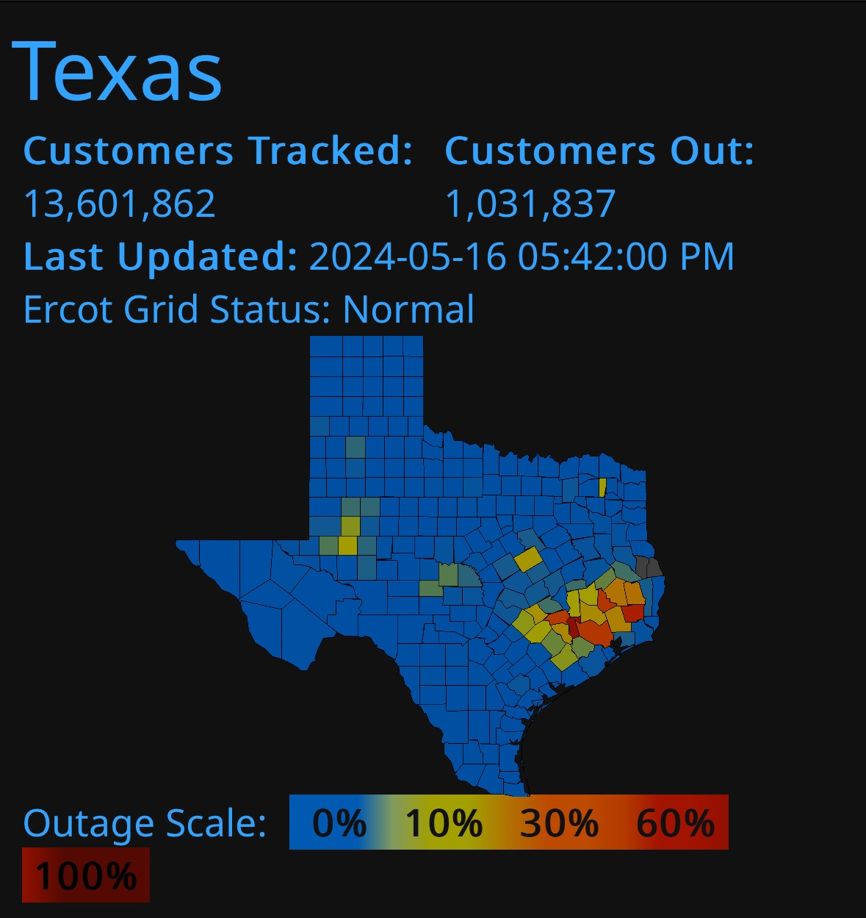
Project Summary
Problem statement:
Current smart-home systems depend on grid power and cloud connectivity, causing lighting and monitoring to fail during outages and creating reliability and usability barriers for users.
Our Solution:
Combine security, lighting control, and user interaction into one coordinated platform
Offer flexible controls, with both local and remote capabilities.
Ensures the home remains safely lit and monitored regardless of grid fluctuations.
Notes:
Kyle

Slide 3
System Overview
Kyle Walcher
Adam Garcia
Solar panel
MPPT charge controller
Android Application
(Kotlin/Java)
3.3v Buck Converteri
12v deep cycle battery
OpenAI/Python Flask Server
ESP32-WROVER
Jack Holdridge
Matthew Greer
12v Buck Boost DC converter
3.3v Buck Converter
‹#›
Database
MCU
Touch screen HMI
ESP32
ESP32
Relay board and LED Lights
Sensors
Notes:
Eric

Slide 4
Project Timeline
Subsystem Designs updated and ready for integration (to complete 2/4/26) | Integration of Database with application (completed 1/28/26) | Integration of light controls with android application (to complete 2/11/26) | Final Integration (to complete 2/25/26) | System Test (to complete 3/4/26) | Validation of system (to complete 3/11/26) | Demo (to complete 4/15/26)
Notes:
Eric

Slide 5
MPPT Charge Controller Adam Garcia
Accomplishments since Status Update #1 18hrs of effort | Ongoing progress/problems and plans until the next presentation
2nd PCB design ordered | Revise ESP32 program Test MCU communication Validate MPPT and Buck converter IC operation.

Slide 6
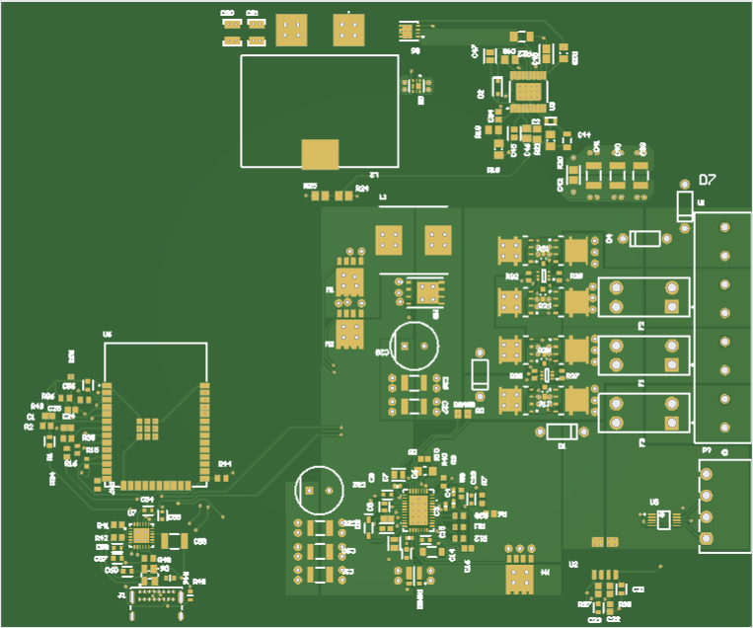
MPPT Charge Controller Adam Garcia

Slide 7
Physical Controls Jack Holdridge
Accomplishments since 403 22 hrs of effort | Ongoing progress/problems and plans until the next presentation
Diagnosed updated 12v converter after validation failure. installed and validated temporary replacement 12v converter with 5 amp stability. Fully assembled Physical Control PCB, programmed latest code, fully validated. 3D modeled PCB housing. | Alternative 12v converter IC selection. 3D print PCB housing. Integrating the database and physical controls communication.

Slide 8
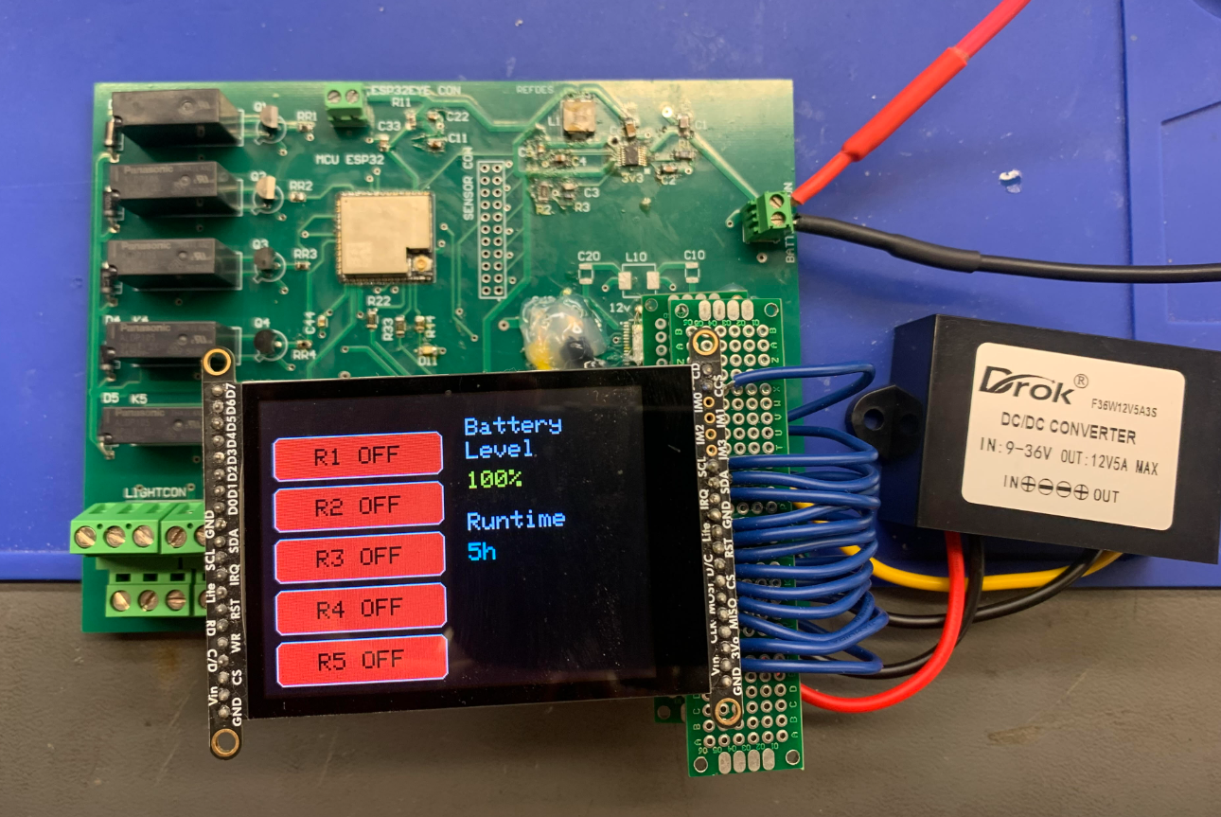
Physical Controls Jack Holdridge
12V Buck-Boost Converter
ITC3119 IC is very particular to layout design and failed due to switching noise.
Temporary replacement DROK 200494 premade converter.
Reviewing buck boost IC with external switches as final replacement.

Slide 9
Android Application and Camera Kyle Walcher
Accomplishments since last update 10 hrs of effort | Ongoing progress/problems and plans until the next presentation
Motion Sensor Notification Code Motion Sensor Logic ESP-32 and Motion Sensor encasing and wiring | Full integration of Motion Sensor and ESP-32 communication/assembly Begin remote control lighting integration with PCB

Slide 10
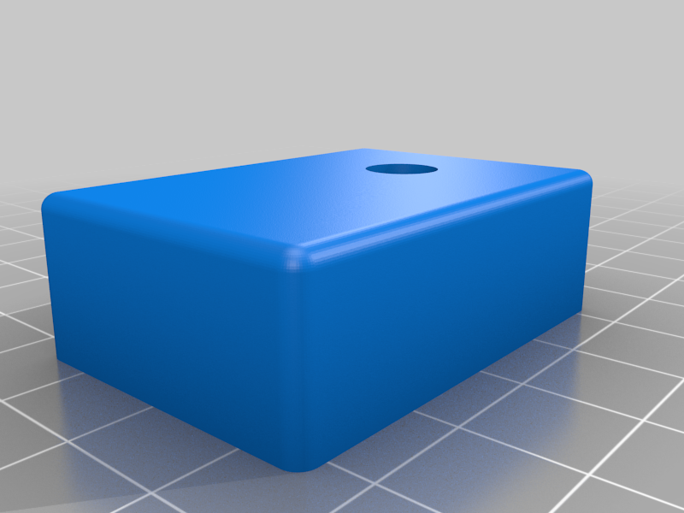
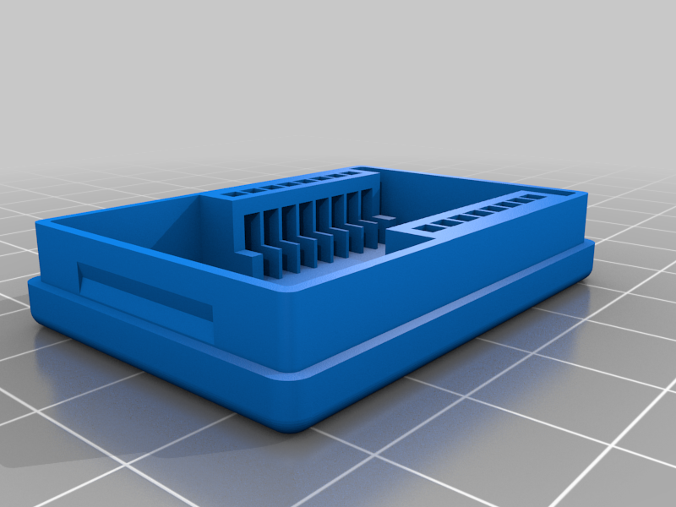
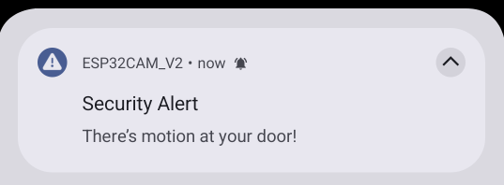
Android Application and Camera Kyle Walcher
ESP-32 Housing
3D Print
45 mm x 31.5 mm x 19 mm
Dupont Jumper Wires
PG7 waterproof gland
Motion Sensor Logic
Motion Detected
Wake + Capture
Upload Event
Notify User

Slide 11
MCU, Sensors & Database Matthew Greer
Accomplishments Update 11 Hours | Ongoing progress/problems and plans until the next presentation
Ordered PIR Motion Sensor Mapped out integration of Database and MCU Scheduled Task for MCU related functions | Integrate database control with mobile app interface Implement software-level integration between MCU and charge controller

Slide 12
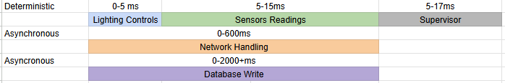
Superloop
Task Scheduling

Slide 13
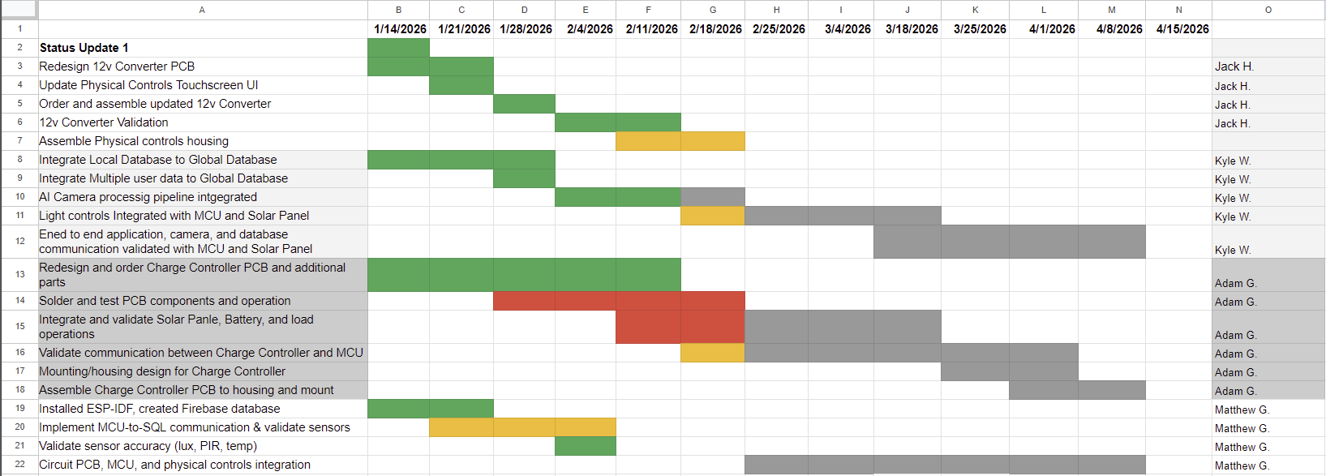
Execution & Plan
Notes:
Michelle

Slide 14
Solar Home Lighting 3:
Thank you for listening!
Questions?
Jack Holdridge
Kyle Walcher
Matthew Greer
Adam Garcia
TA: Guanhua Tao
Sponsor: Won Jang
‹#›

